Slide 1

Project 2
Diabetes Predictions
Group 5:
Frances Hollan, Nick Santos,
Edilberto Vinas, Al Wagner
Design by LoveSlides
*Image from: https://blogs.biomedcentral.com/on-medicine/2018/01/30/weighing-up-the-costs-of-type-2-diabetes-prevention-programs/

Slide 2
Table of Contents
Executive Summary
Overview of Data
Approach
Future Considerations and Changes
Results and Conclusions

Slide 3
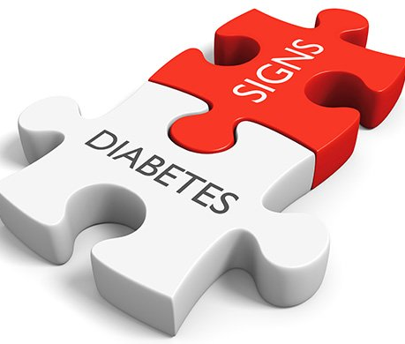
Executive Summary
Our project model helps health clinicians deliver patients a probability of their chances of contracting diabetes.
Initially we had planned to create this chatbot for patients to use. We pivoted, given that the data set included clinical categories that a patient might not be aware of like hypertension and blood glucose levels, HbA1c scores or body mass index. As such, we decided that qualified health clinicians would be a better target audience
Since the dataset answers are binary to our query of, "does the patient have diabetes?", our initial approach was to use logistic regression to create the predictive model.
Although the accuracy score for the Logistic Regression was only 88% (in comparison to the 99% accuracy score of the Random Forest classifier), it's ability to give a percentage to a health clinician made for a more reliable model in the field.
*Image found at: https://www.dreamstime.com/stock-illustration-diabetes-mellitus-metabolic-disease-signs-symptoms-concept-d-rendering-rendered-healthcare-two-puzzle-pieces-joined-image92848592

Slide 4
Overview of Data Set
Included nine initial fields, most of which are generally considered indicators for diabetes (age, hypertension, smoking history, blood glucose level, body mass index, HbA1c level and gender). The data set was comprised of 100,000 patients giving us a healthy sample size.
Data Collection
The Diabetes prediction dataset is a collection of medical and demographic data from patients, along with their diabetes status (positive or negative). The data includes features such as age, gender, body mass index (BMI), hypertension, heart disease, smoking history, HbA1c level, and blood glucose level.
Clean Up
Converting relevant variables to get dummies.
Split training and testing sets
We tried all classification models and neural networks but concluded logistic regression and random forest fit our data best
Optimization
Oversampled and undersampled Logistic Regression
undersampled and oversampled Random Forest
Cross validation
Hyper parameter tuning

Slide 5
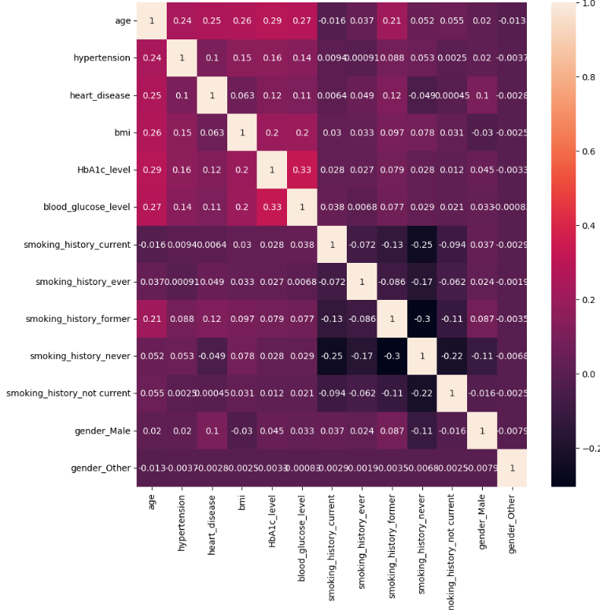
Dataset
Correlation plot of the X_train variables
No significant correlation was found between variables
100K observations, 91.5K have no diabetes, 8.5K have diabetes
All data are medically considered predictors of diabetes in medicine

Slide 6
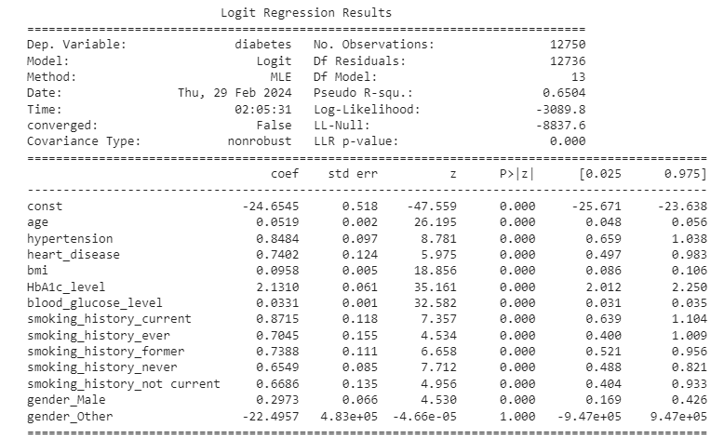
Model - Logistic Regression
Logistic Regression
Suggests all variables are highly significant
HbA1c level is most impactful
Hypertension second most impactful

Slide 7

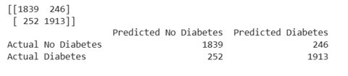

Model - Logistic Regression
Undersampled: .88
Standard: .95

Slide 8
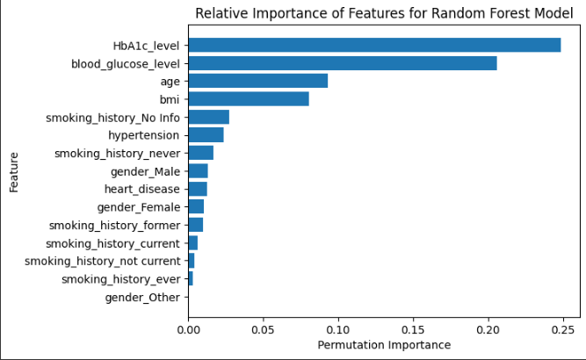
Model - Random Forest
Relative influence plot for Random Forest
HbA1c level and Blood glucose level are most influential for decision making if patient has diabetes

Slide 9
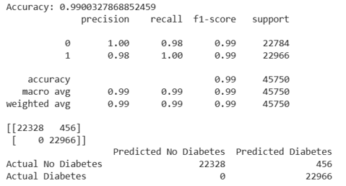
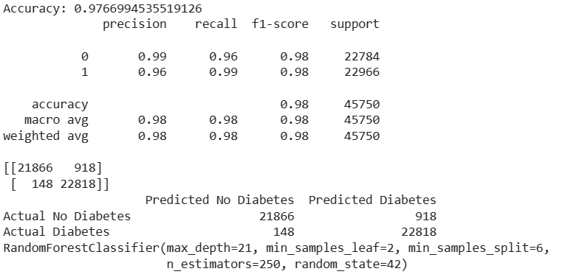
Model - Random Forest
standard no cross validation
cross validation and tuned

Slide 10
Approach
Our Initial approach was logistic regression to create the predictive model.
After running a confusion matrix a 36% reporting of false negatives were received.
While undersampling of logistic regression was reduced to 10% false negatives.
Using the Random Forest classifier created the most accurate model, scoring an accuracy score of 99%. Although we all acknowledged the risk of having a slightly overfit model the decision was that we were willing to live with more false-positive.
To optimize our data we chose to oversample and undersample our two main models (Linear Regression and Random Forest) to combat against bias and the false-negatives we were encountering.
There was a concern with the Random Forest classifier, as it had an accuracy score of 99%, being overfit. To treat this the group cross validated the model with hyperparameter tuning which brought the accuracy score down to 97%.

Slide 11

Future Considerations and Changes
Create an AI Chatbot trained to run the model to give the user a percentage of risk of diabetes.
Investigate more features on Neural Network algorithms.
Search for more datasets to add into model.
Discuss with health care professionals how to fine-tune the model and balance false positives to false negatives.
*https://nordvpn.com/wp-content/uploads/blog-featured-what-is-chatbot.svg

Slide 12
Statistics About Diabetes
Diabetes was the eighth leading cause of death in the United States in 2021 based on the 103,294 death certificates in which diabetes was listed as the underlying cause of death. In 2021, diabetes was mentioned as a cause of death in a total of 399,401 certificates.
Prevalence
In 2021, 38.4 million Americans, or 11.6% of the population, has diabetes.
The percentage of Americans age 65 and older remains high, at 29.2%, or 16.5 million seniors (diagnosed and undiagnosed).
Diagnosed and Undiagnosed
Of the 38.4 million adults with diabetes, 29.7 million were diagnosed, and 8.7 million were undiagnosed.
New Cases
1.2 million Americans are diagnosed with diabetes every year.
Prediabetes
In 2021, 97.6 million Americans age 18 and older had prediabetes.
https://diabetes.org/about-diabetes/statistics/about-diabetes

Slide 13
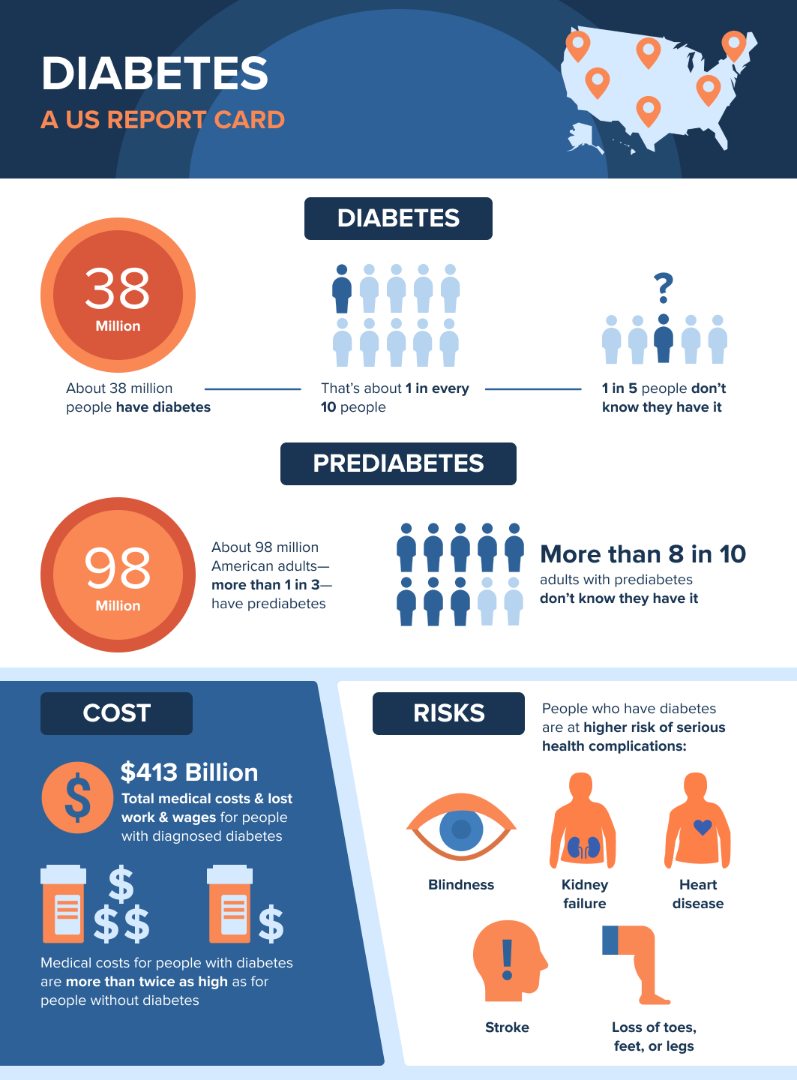
Diabetes symptoms
Unexplained Weight Loss
Fatigue
Blurred Vision
Frequent Infections
Numbness or Tingling in Extremities
Darkened Skin Areas
Image from:
https://www.cdc.gov/diabetes/library/socialmedia/infographics/diabetes.html

Slide 14
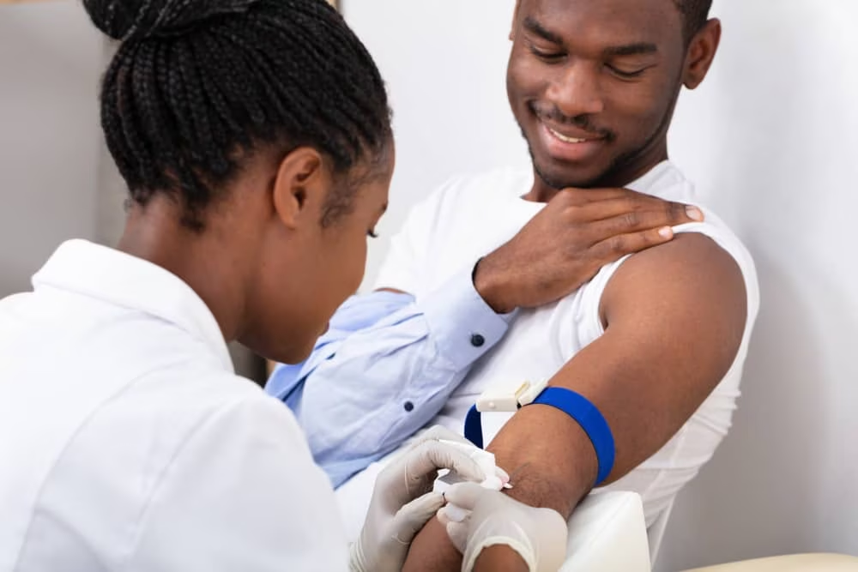
Results and Conclusions
While unable to implement a chatbot feature we were still successfully able to output logistic regression and random forest models with high accuracy.
We landed on using a Logistic Regression model as our main focus because of its flexibility and the fact that it provides the user with a percentage of likelihood rather than just classifying a patient as diabetic or non-diabetic. Although the accuracy score for the Logistic Regression was only 88% its ability to give a percentage to a health clinician made for a more reliable model in the field.
The Logistic Regression model also put the responsibility on a qualified health clinician to make the final call. It provides them the chance to adjust where in that percentage spectrum a "yes" or "no" determination would land.
https://www.niddk.nih.gov/-/media/Images/Health-Information/Diabetes/doctor-injecting-patient_1000x667.jpg

Slide 15

Questions

